Slide 1

Welcome to our phonics, reading and writing information sharing session

Slide 2
Phonics and Early Reading
Part 1 - Information about how we teach phonics
Part 2 - Information about how we teach reading
Part 3 – Information about how we teach writing
Part 4 - Supporting at home

Slide 3
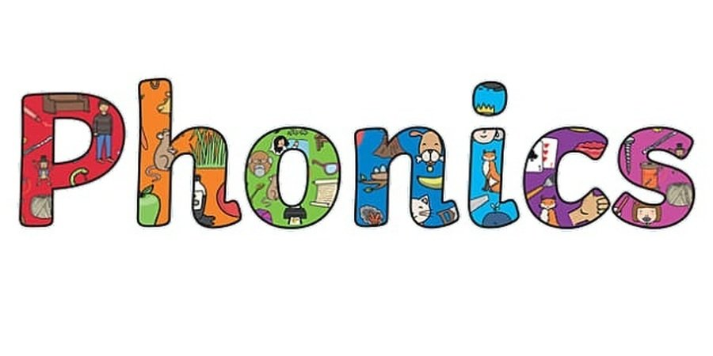
What is Phonics?
Phonics is a way of teaching children how to read and write.
It helps children to hear, identify and use different sounds that distinguish one word from another in the English language.

Slide 4
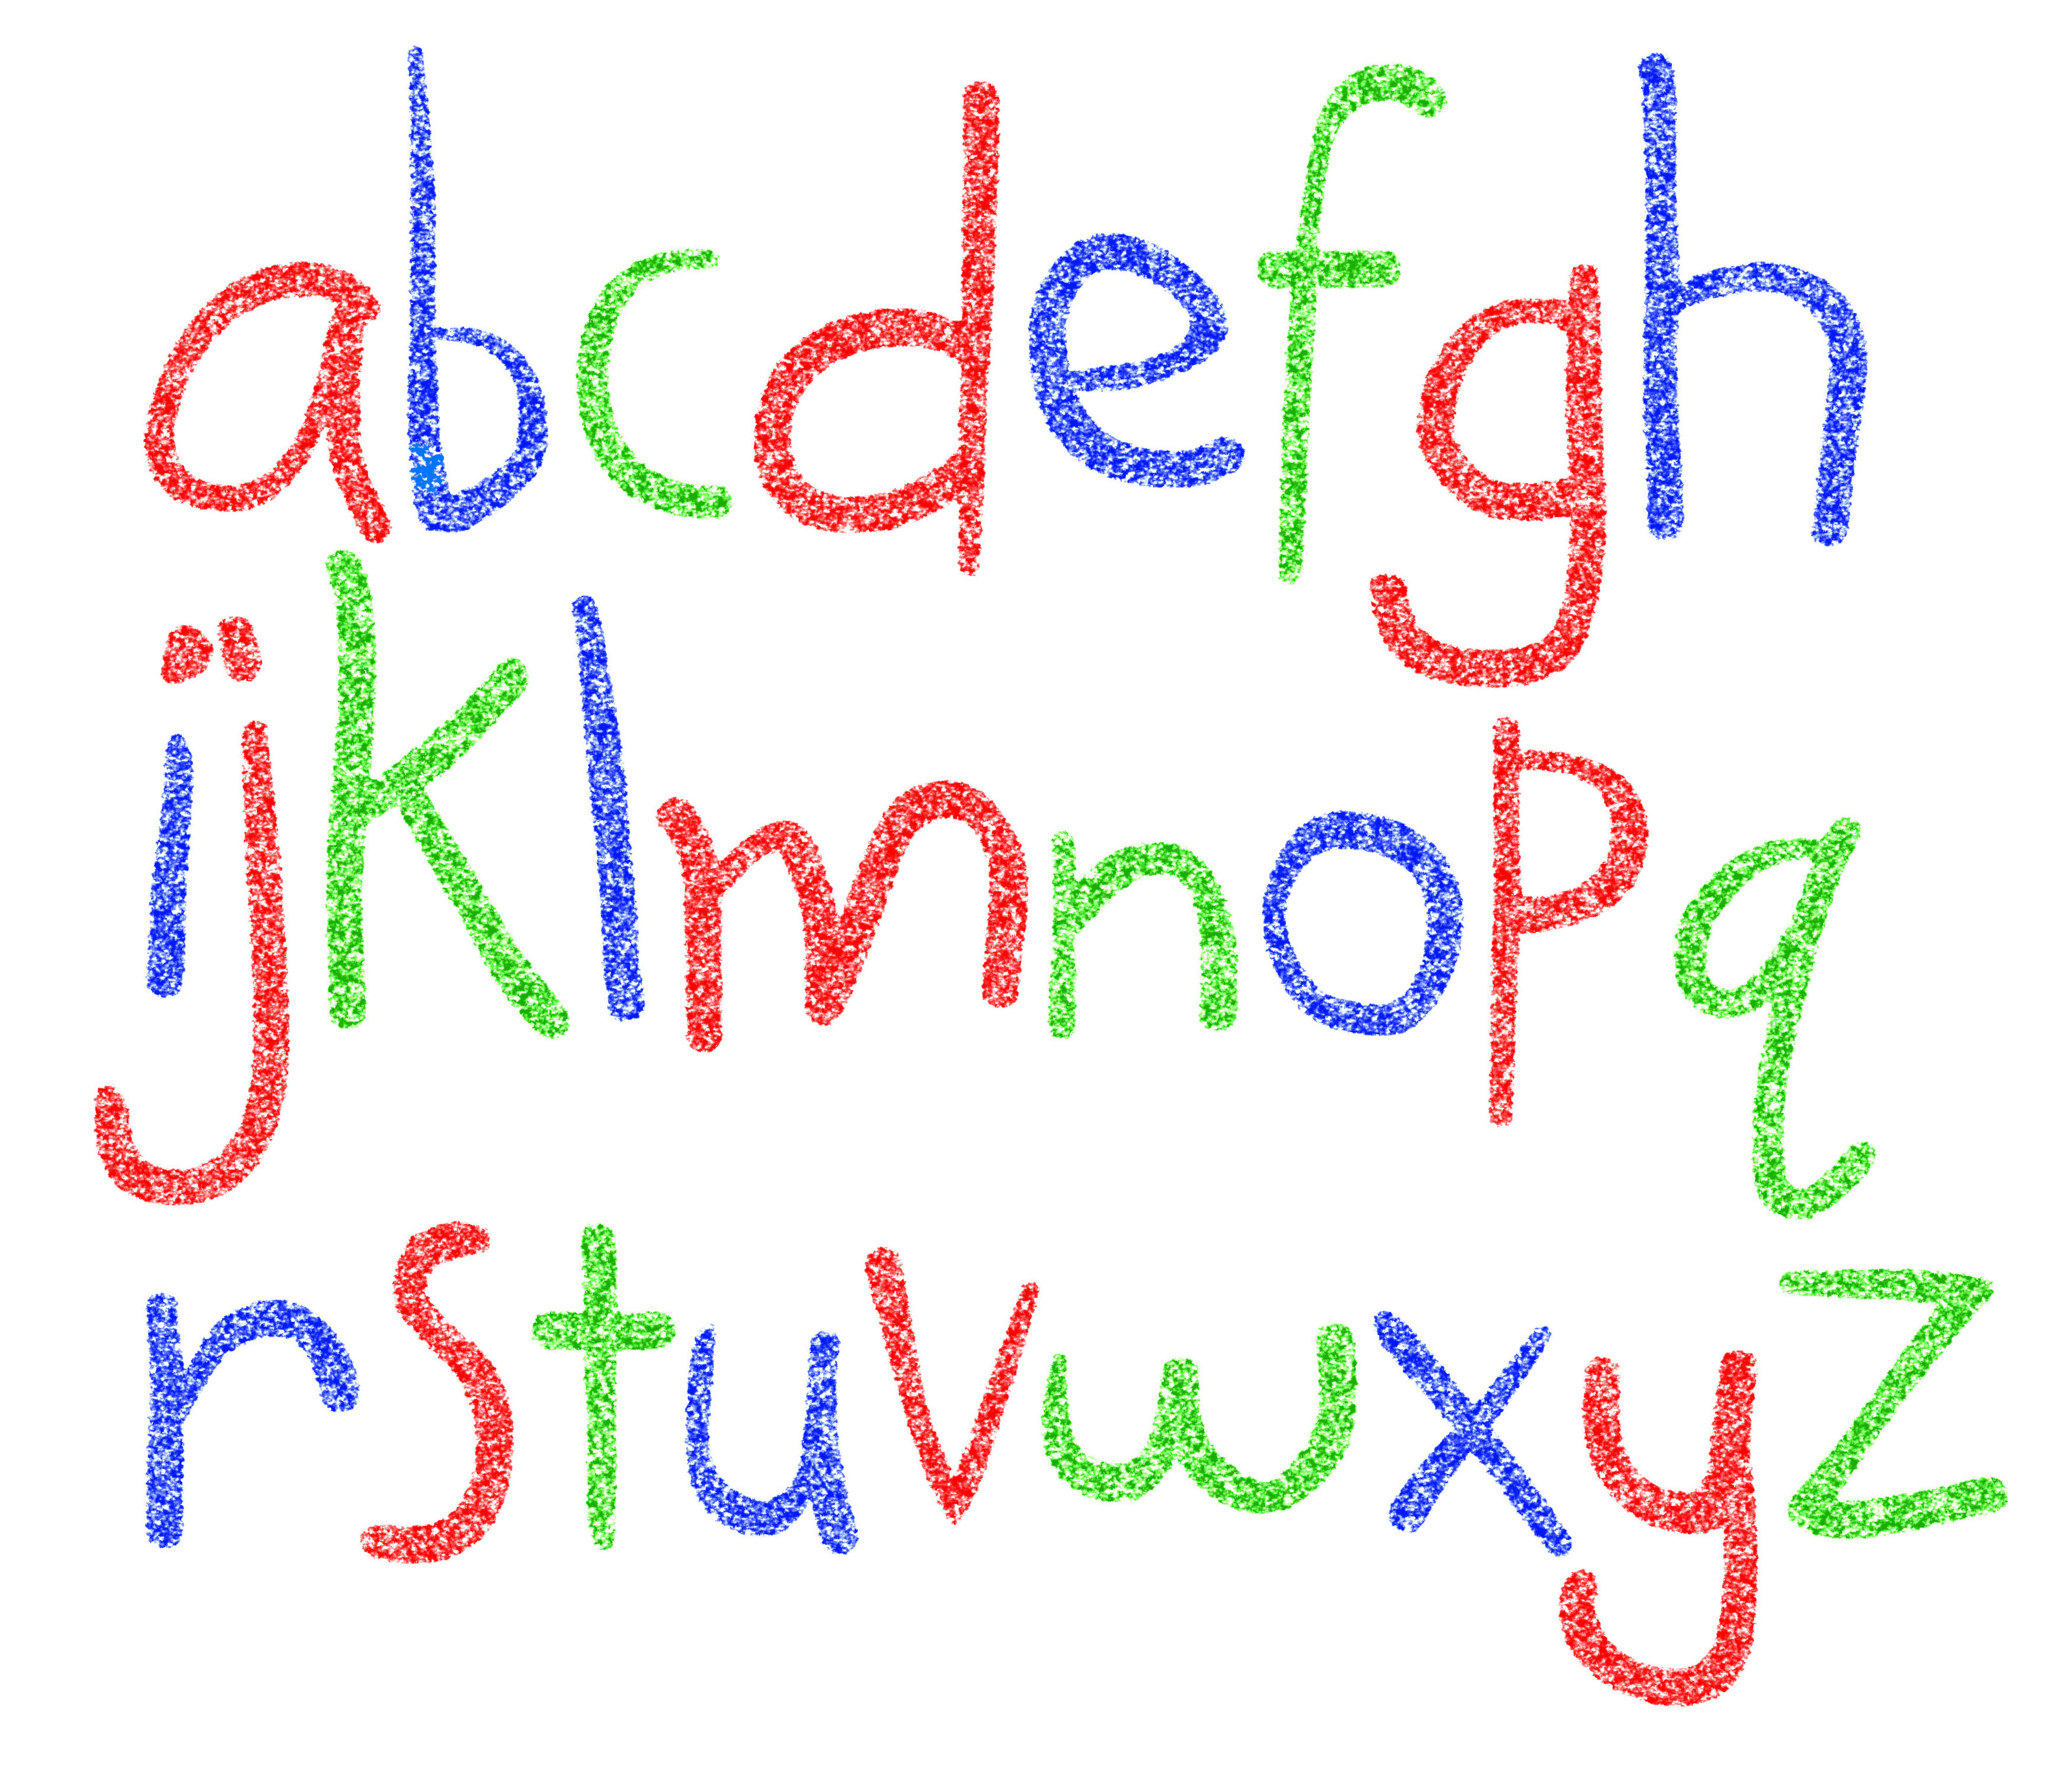

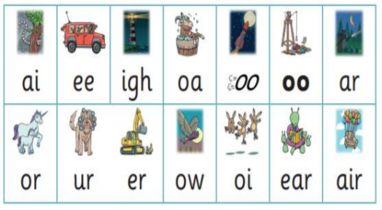
Did you know?
The English language has:-
26 letters
44 sounds
Over 100 different ways to spell
those sounds

Slide 5

New DFE Guidance for Early Reading and Phonics
The journey to independent reading and writing begins with Phonics
littlewandlelettersandsounds.org.uk
Why Little Wandle?
Excellent training for all staff to ensure consistency.
Every aspect of phonics and reading included in a detailed, thorough and systematic approach.
Engaging resources without distracting from the learning.
Comprehensive system for identifying and supporting children requiring extra help.
Useful support for parents.
Notes:
Government changes mean a change (for the better) in how we teach phonics and reading at school - make sure there is consistency throughout
Early reading is the stage where children are learning to become fluent readers through the use of phonics

Slide 6
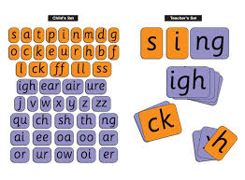
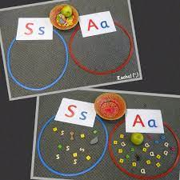
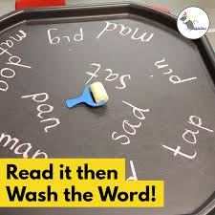
How we teach phonics
Daily phonics sessions for all children in
Reception, Year 1 and Year 2
Phonics catch up sessions to close gaps
Specific order of teaching
m-u-s-t
Correct pronunciation
- is vital - Videos on LW
https://www.littlewandlelettersandsounds.org.uk/resources/for-parents/
Repeated practice
Revisit previously
taught sounds at the
start of each lesson
Practice makes
permanent

Slide 7
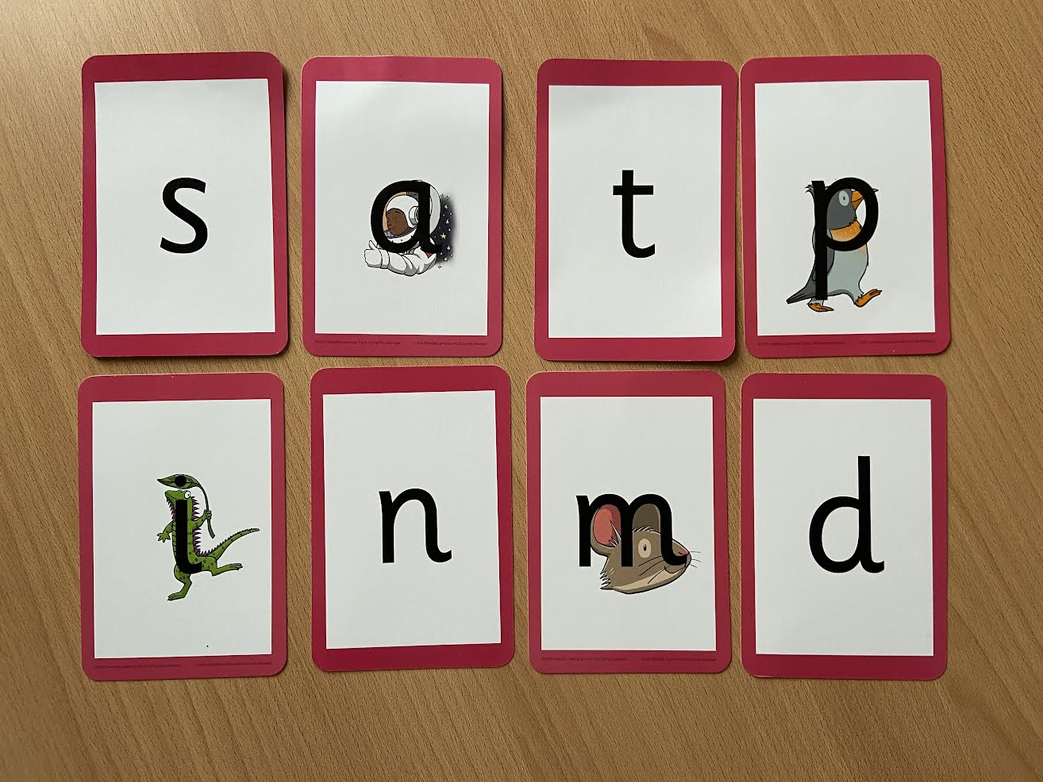
Notes:
Phonemes taught in order start to read words asap
LW has a picture pneumonic to help children remember the phoneme/grapheme

Slide 8
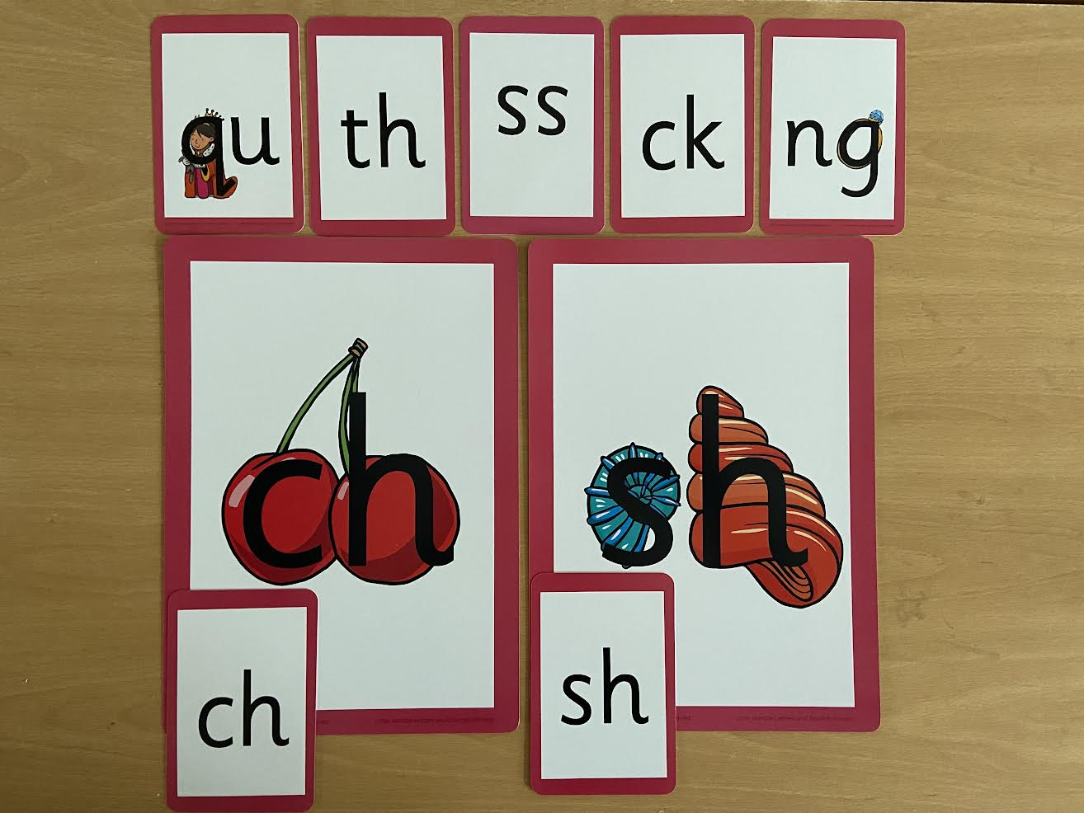
Notes:
Early digraphs mostly consonant digraphs – 2 letters 1 sound

Slide 9
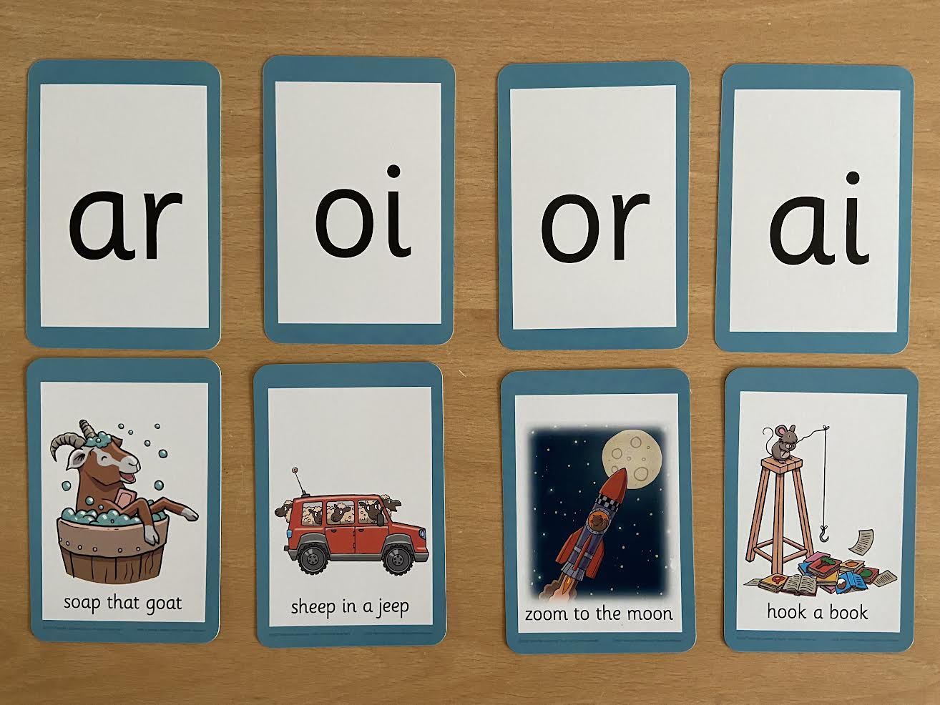
Notes:
Vowel digraphs taught with a short caption to help children remember
Also trigraphs igh, air

Slide 10
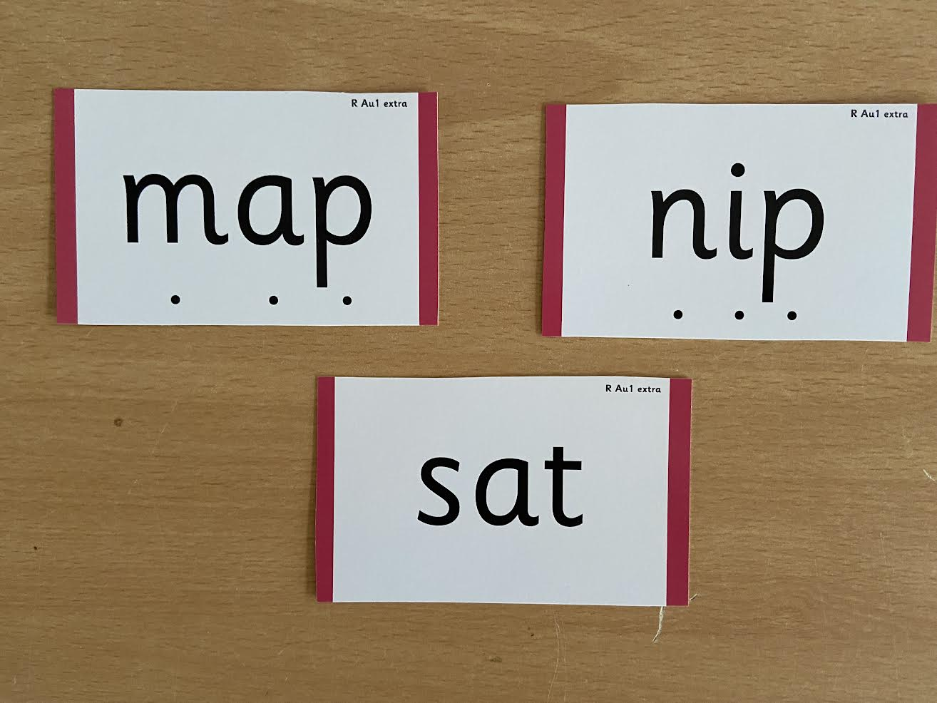
Notes:
During phonics lessons we use Sound buttons so we can sound talk and blend to read

Slide 11
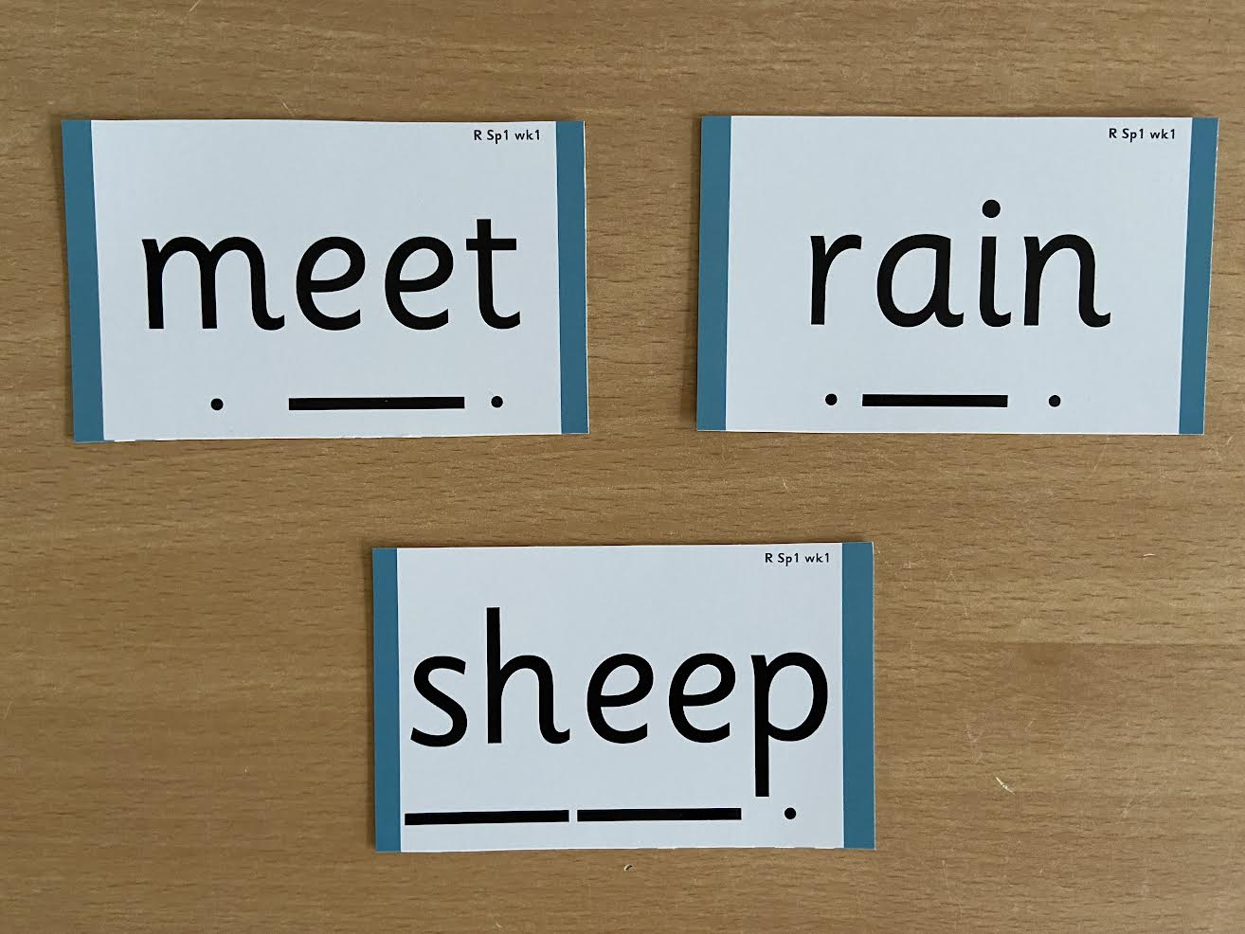
Notes:
Digraphs have a zip to sound talk and blend

Slide 12

Notes:
Words that do not follow the rules and cannot be decoded – tricky words/ exception words
Chn are taught what part of the word is tricky

Slide 13

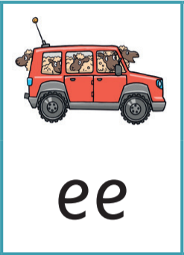

Jargon
You may hear your children say….
-Phonics (also known as ‘synthetic phonics’) – The teaching of reading by developing awareness of the sounds in words and the corresponding letters used to represent those sounds.
-Phoneme - Any one of the 44 sounds which make up words in the English language.
-Grapheme – How a phoneme is written down. There can be more than one way to spell a phoneme. E.g-the phoneme ‘ay’ is spelt differently in each of the words ‘way’, ‘make’, ‘fail’, ‘great’, ‘sleigh’ and ‘lady’.
-Blending – Putting together the sounds in a word in order to read it, e.g.
‘f – r – o – g, frog’
-Segmenting – Breaking a word into sounds in order to spell
them, e.g. ‘frog, f – r – o – g’’
-Digraph- 2 letters making one sound
-Trigraph- 3 letters making one sound

Slide 14

Reading
We want children to
love reading
Learning to read should be
a positive experience
Reading should be
enjoyable
We want children to read
for pleasure and be life
long readers
Reading underpins children’s access to the curriculum
and clearly impacts on their achievement
Notes:
We all know how important learning to read is and the impact it has on a childs success - it has to be a positive experience
Whats the reality? Reluctant to read because they find it hard
Frustration stress tears – that’s just the parents
Important to look at the big long term picture

Slide 15
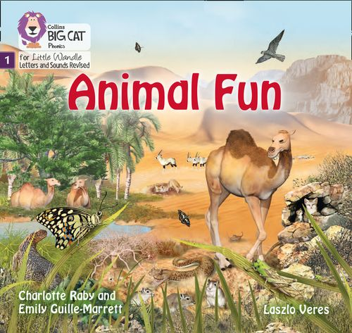
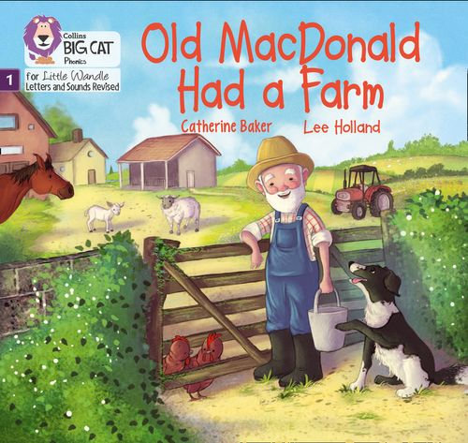
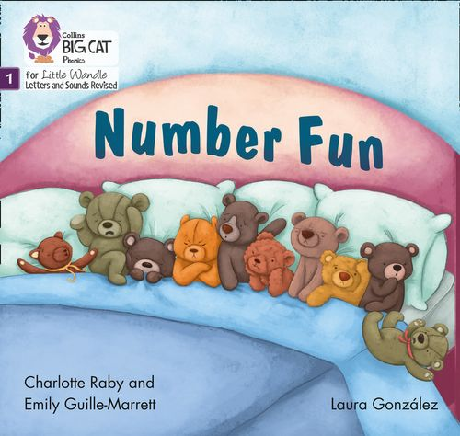
Once children have a secure knowledge of a number of
GPC’s (Grapheme Phoneme Correspondences)
and are confidently blending, they will be ready for
reading books.
Prior to this they will have wordless books which develop
great language skills and teach children the layout of books
and how to handle books.

Slide 16

How we teach reading
Reading practice sessions are:
Books are:
Timetabled 3 times a week
Matched to children’s
secure phonic knowledge
and word reading
Taught by a trained teacher or
teaching assistant
Read three times
Taught in small groups
Sent home
Notes:
Quite a big difference to how reading was previously taught

Slide 17
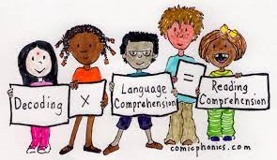
Reading practice books are carefully matched so children can read
fluently and independently.
3 Reads – each one begins with some quick sounds and words practice.
Decoding
Prosody
(intonation, expression)
3. Comprehension
When children take their book home to read the aim is for them to be developing
fluency. Please do not worry that a book is too easy – your child needs to develop
fluency and confidence in reading. Re-reading a book that they have had before
helps to develop fluency too – this is the goal.
Celebrate their success!!!

Slide 18
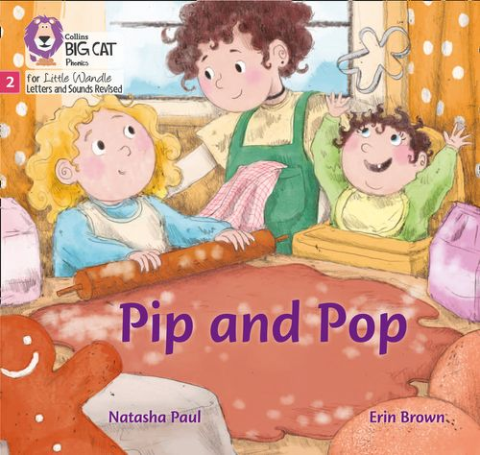

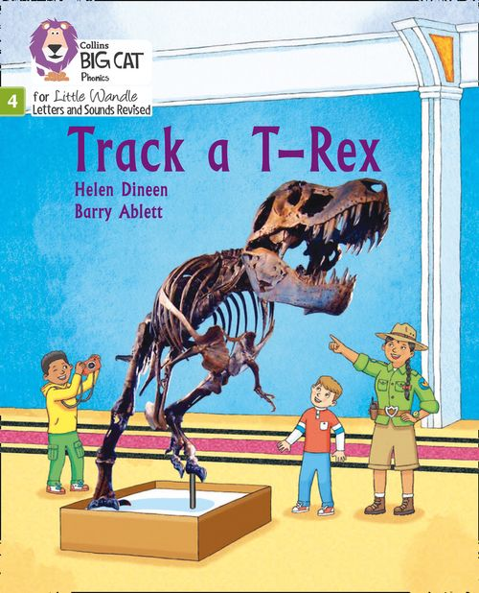
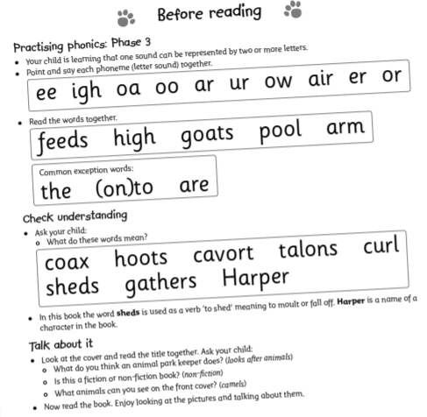
How do we decide which books children read?
Children are assessed, then LW matches which books
Should be allocated for their secure phonic knowledge.
Children will take their Reading Practice Book home
(after reading it 3 times in school).
Share the front cover page before reading – this
covers the sounds and words contained in the book.
Celebrate, praise, talk about the book with you child.
Please make sure books are in book bags and
always returned on Wednesday as they will be
needed for other groups. Initially children will access
their e-books until enough sounds have been covered
and children can read a variety of books.
Please take care of our books, plastic wallets will be
provided to store them in.
Notes:
Children will not be changing book multiple times a week as previously
Reading groups will be set up so you will be notified of when your book will be sent home/ need to be back in school
Groups will change!

Slide 19


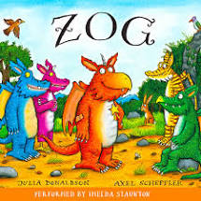


Supporting at home
Reading for pleasure books
Children will also have the opportunity to bring home a ‘reading for pleasure book’ from our class library each week.
To become lifelong readers, it is essential that they read for pleasure.
Children will not be able to read this book independently, but these books offer a wealth of opportunities for talking about the pictures and enjoying the story or information text.
Enjoy the book together and
foster a love of reading.

Slide 20
What else can parents do?
Please look at the Little Wandle videos and guidance for parents
Support children with home learning to reinforce what they have covered in school
Let your child “show off” their reading to you and celebrate and praise all the way!
Share books with your children for pleasure
Check on our class page for documents to support reading and phonics

Slide 21
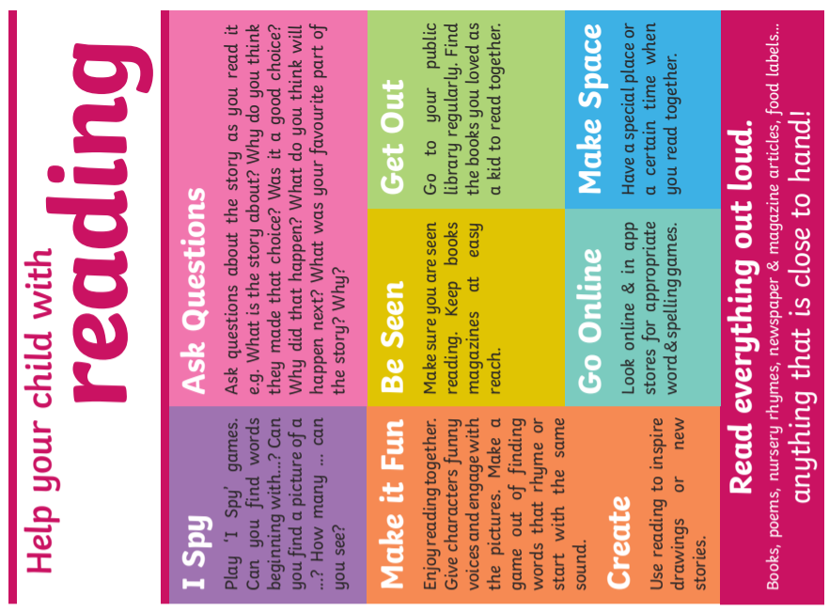
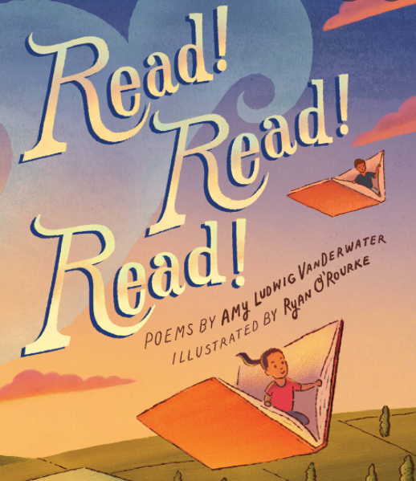

Slide 22
Websites for Phonics games:
Phonics Play - https://www.phonicsplay.co.uk/
Phonic Bloom - https://www.phonicsbloom.com/
Topmarks - https://www.topmarks.co.uk/english-games/5-7-years/letters-and-sounds

Slide 23
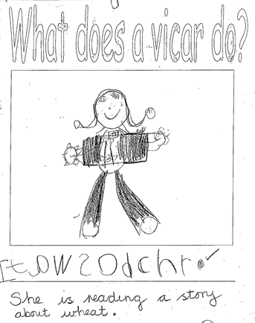
Development of Writing
The journey to becoming a writer begins with children mark making, they then ascribe meaning to the marks that they make.
Children learn to form letters through daily handwriting sessions and apply this to writing words and later on sentences as part of their phonics lesson.
Children often begin writing letters that are in their name, and then the initial sounds in words before then writing words including the initial and end sounds before eventually writing all of the sounds that they hear in a word. As part of our writing lessons we also model and work on using finger spaces, full stops and the correct spelling of our ‘tricky words’.

Slide 24
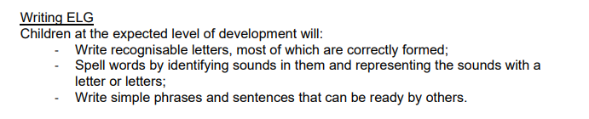
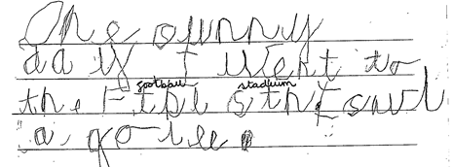
Reception Early Learning Goals

Slide 25
How we teach writing
Reading and re-telling high quality texts- fiction, non-fiction and poetry
Handwriting lessons
Phonics lessons
Tricky words- recognised by sight
Discussion around features of writing in guided reading sessions
Helicopter stories
Modelling and teaching grammar and punctuation
Guided writing lessons

Slide 26
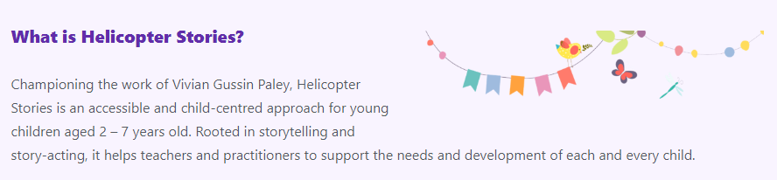
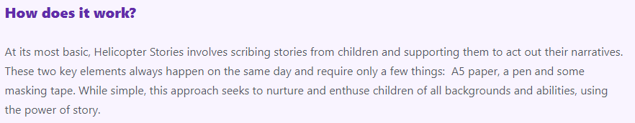
Helicpoter stories
In order to promote a love of story-telling for all children, we develop an approach called ‘helicopter stories’ to enable children to tell their stories and work with others to bring them to life.

Slide 27
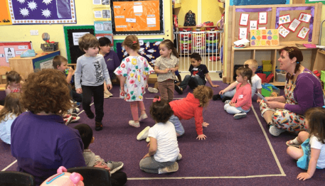
Why do Helicopter Stories?
Child centred
Language rich
Enhanced speech and language skills
Eagerness to write
Developing story telling
Communication skills
Creativity
Freedom of expression
Inspires curiosity

Slide 28
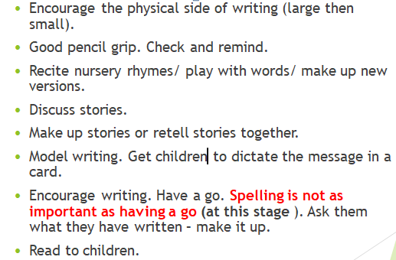
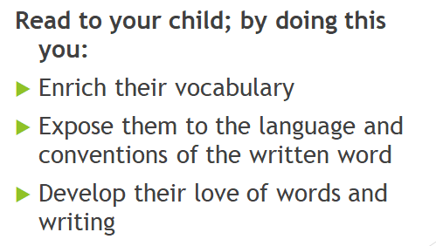
Supporting at home

Slide 29

Any questions ???
Thank you for joining us!

